Slide 1

CRITICALLY ENDANGERED AND ENDANGERED SPECIES
SUBMITTED BY
ANGELINE RESHMA
SHANMATHI. K
JEEVAPRIYADHARSHINI
SHARMA. C
ADITHYAN VINOD

Slide 2
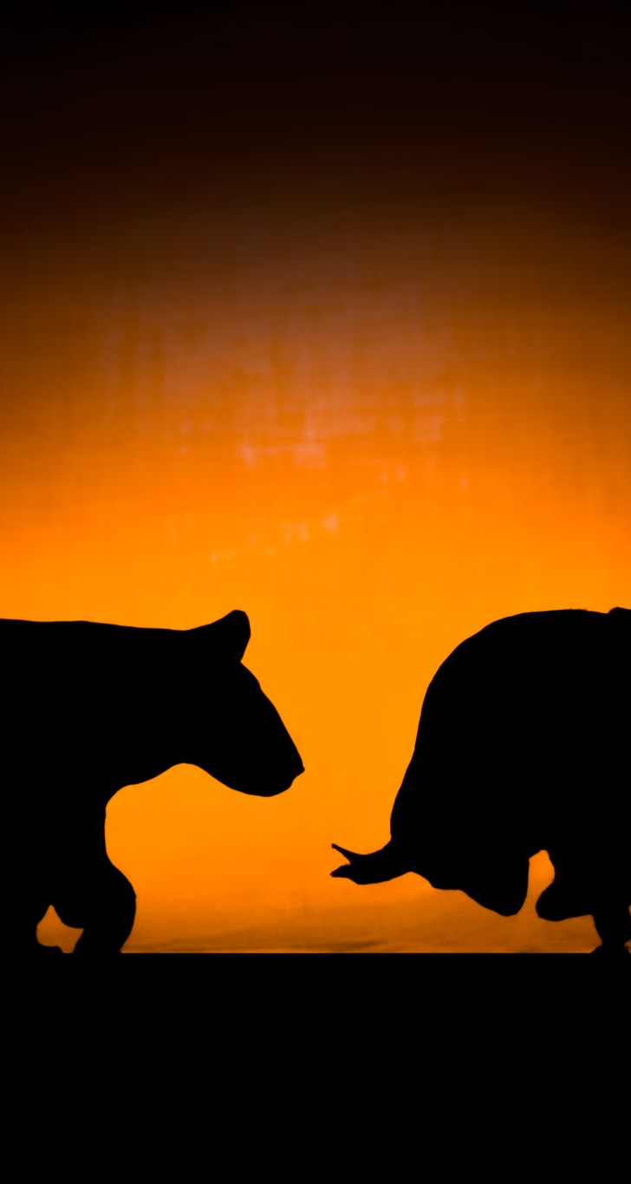
Introduction
Endangered species are referred to as those species that are considered at the risk of extinction.
Their population declined from 50 to more than 70 percent over the past 10 years.
The Wild Life (Protection) Act, of 1972 provides a legal framework for the protection of various species of wild animals and plants, management of their habitats, regulation, and control of trade in wild animals, plants, and products made from them

Slide 3
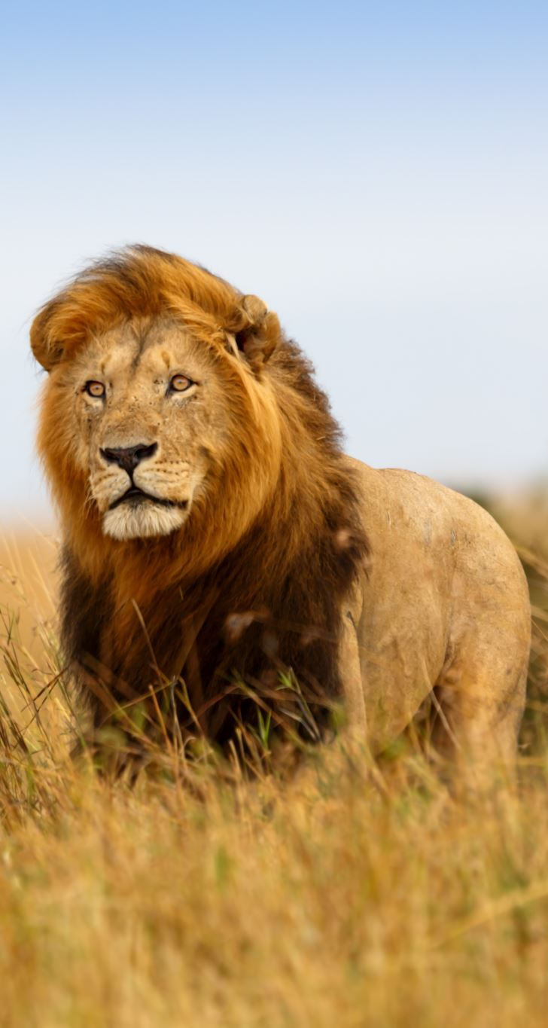
ENDANGERED SPECIES
Endangered species are referred to as those species that are considered at the risk of extinction. Their population declined from 50 to more than 70 percent over the past 10 years. Examples of endangered species include giant panda (Ailuropoda melanoleuca), lion-tailed macaque (Macaca silenus) of the Western Ghats of India, blue whale (Balaenoptera musculus), Asiatic wild ass (Equus hemionus) of Rann of Kutch, black lemur (Eulemur macaco), Siberian crane (Leucogeranus leucogeranus) of the Ghana National Park.

Slide 4
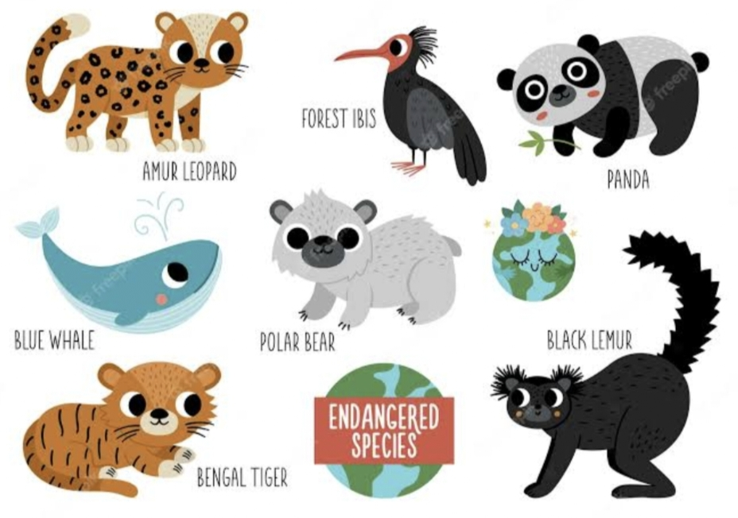
ENDANGERED SPECIES

Slide 5
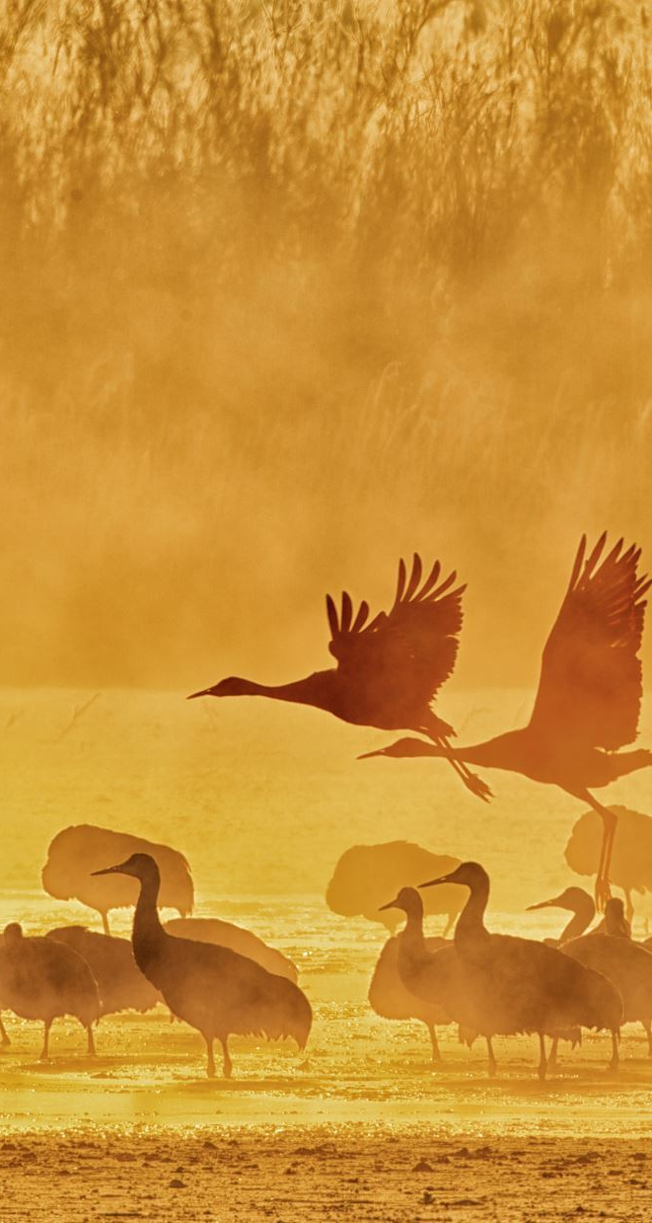
CRITICALLY ENDANGERED SPECIES
According to the IUCN list, these species are categorised as those ones that are at a very high risk of becoming extinct in the wild. Their population declined 80 to more than 90 percent over the past 10 years. The reasons include rapid population reduction, geographic reduction, low number of adults, and low overall population size.
Example : Malabar Civet, Javan Rhino

Slide 6
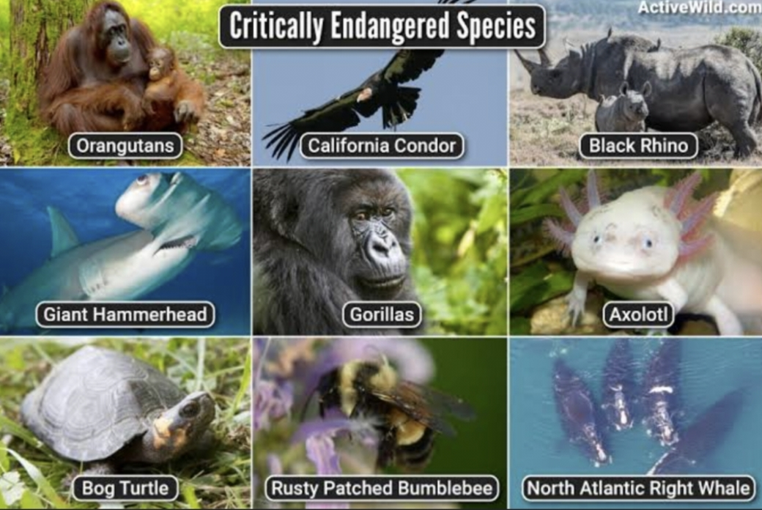
CRITICALLY ENDANGERED SPECIES

Slide 7
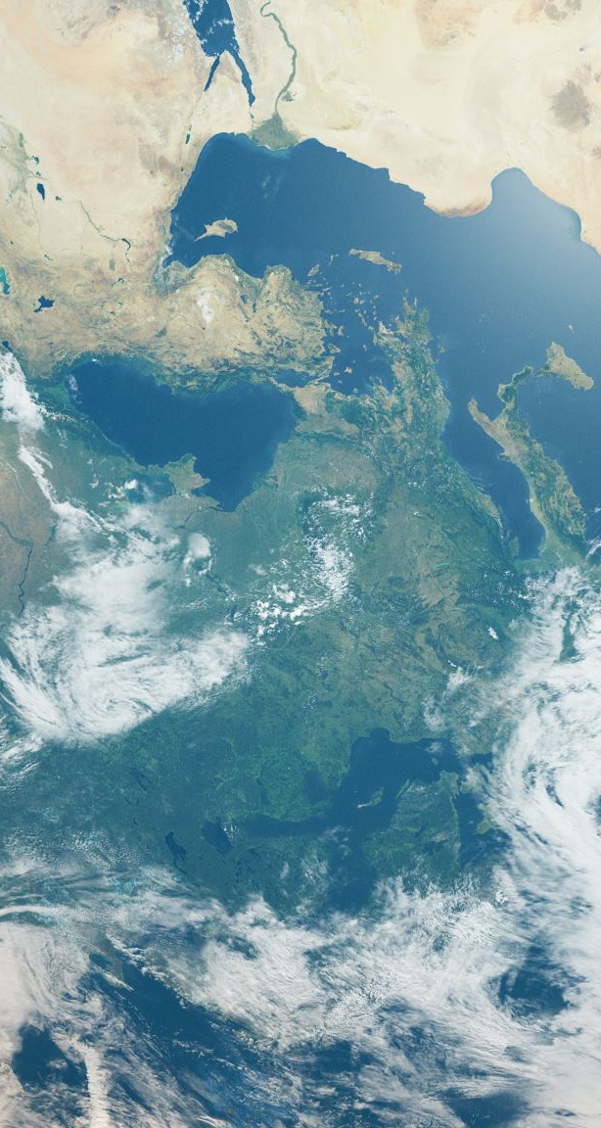
IUCN
The International Union for Conservation of Nature (IUCN) is a membership Union uniquely composed of both government and civil society organisations. By harnessing the experience, resources and reach of its more than 1,400 Member organisations and the input of some 15,000 experts, IUCN is the global authority on the status of the natural world and the measures needed to safeguard it.

Slide 8

RED DATA BOOK
The Red Data Book is referred to as the public document that records the information about all rare and endangered species of plants, animals, and fungi existing within the boundary of a state or territory. It can be considered as a catalogue of species facing the risk of extinction. This book also contains the records of local subspecies that are native to a particular region. The Red Data Book assists us in gathering comprehensive data for research, studies, and monitoring programs involving rare and endangered animals and their ecosystems. The purpose of creating the Red Data Book is to identify and protect the species that are on the verge of extinction.

Slide 9

COLOR CODING IN RED DATA BOOK
The Red Data Book is a collection of colour-coded information sheets organised by the danger of extinction for a variety of species and subspecies. The colour coding is done in the following way:Black colour represents the species that are confirmed to be extinct.Red colour represents the endangered species.Amber colour represents those species that are considered to be vulnerable.Green colour represents all species that are out of danger. The species which were previously endangered but whose number started to recover fall under this category.

Slide 10

COLOR CODING IN RED DATA BOOK
Grey colour indicates those species that are classified as vulnerable, endangered or rare but sufficient information is not available about these species.White colour represents all rare species which are not evaluated.

Slide 11
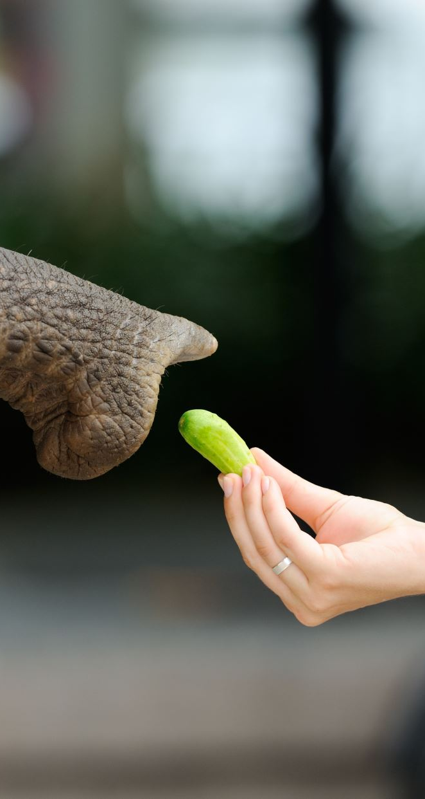
WHY SPECIES BECOMING ENDANGERED?
An endangered species is a type of organism that is threatened by extinction. Species become endangered for two main reasons: loss of habitat and loss of genetic variation.
Loss of Habitat
A loss of habitat can happen naturally. Dinosaurs, for instance, lost their habitat about 65 million years ago. The hot, dry climate of the Cretaceous period changed very quickly, most likely because of an asteroid striking the Earth. The impact of the asteroid forced debris into the atmosphere, reducing the amount of heat and light that reached Earth’s surface. The dinosaurs were unable to adapt to this new, cooler habitat. Dinosaurs became endangered, then extinct.

Slide 12
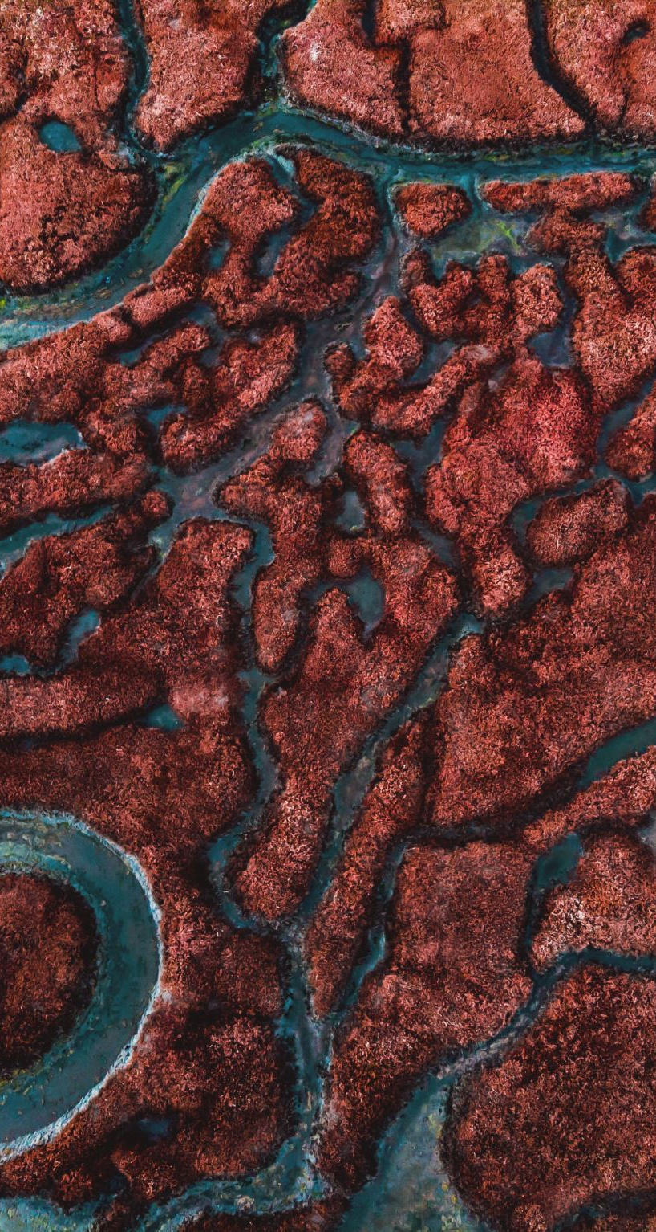
WHY SPECIES BECOMING ENDANGERED?
Loss of Genetic Variation
Genetic variation is the diversity found within a species. It’s why human beings may have blond, red, brown, or black hair. Genetic variation allows species to adapt to changes in the environment. Usually, the greater the population of a species, the greater its genetic variation.

Slide 13

IUCN RED LIST
Established in 1964, The International Union for Conservation of Nature’s Red List of Threatened Species has evolved to become the world’s most comprehensive information source on the global conservation status of animal, fungi and plant species.The IUCN Red List is a critical indicator of the health of the world’s biodiversity. Far more than a list of species and their status, it is a powerful tool to inform and catalyze action for biodiversity conservation and policy change, critical to protecting the natural resources we need to survive.

Slide 14
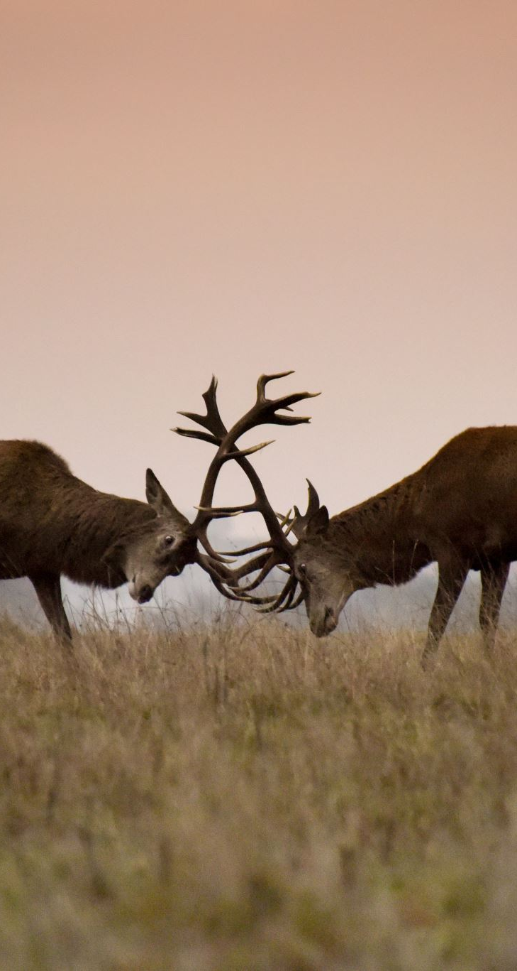
IUCN RED LIST
It provides information about range, population size, habitat and ecology, use and/or trade, threats, and conservation actions that will help inform necessary conservation decisions
Example : Marsh Deer, Hog Deer, Wandering Albatross.

Slide 15
REFERENCE
- Endangered species
- Red Data Book : What are red data book? Definition, Types and Importance - biology | AESL. (n.d.).
-Why species become endangered : Endangered species. (n.d.).

Slide 16
THANK YOU

